Slide 1
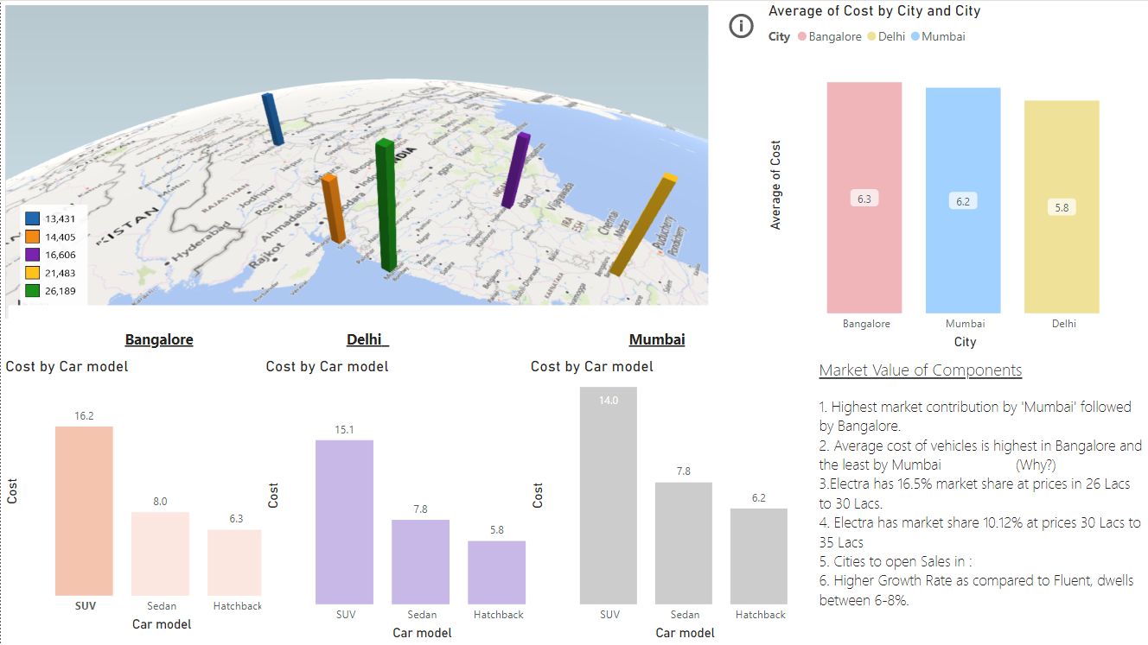
Operational Cost of Vehicles Management Dashboard

Slide 2
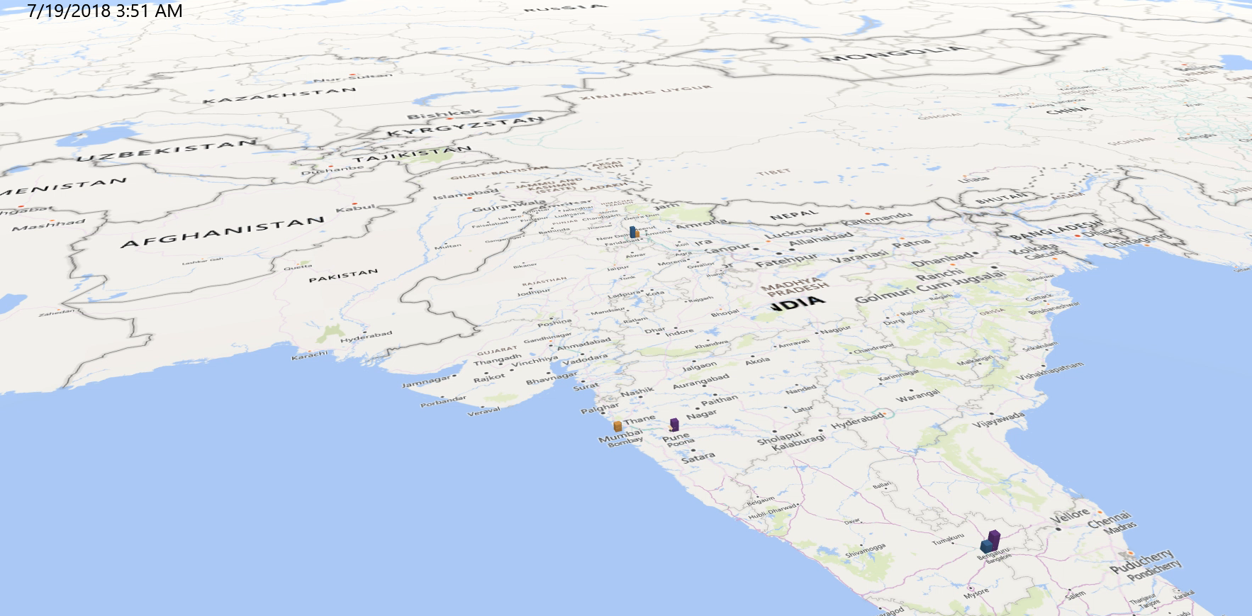
Vehicle Model to City comparison (on 2018-19 data)
Delhi has the highest usage of SUV and hatchbacks
There is low to no competition in places like Pune
Sedans are in higher demand in Southern India, Bangalore
The company has expanded the most in Delhi in the past 2 years.
Video (above)

Slide 3
City | Subsidy | Insurance | Maintenance cost per year | Road Tax | Cost (lacs)
Delhi | 0.05 | 70000 | 7100 | 130000 | 15.0716305
Mumbai | 0.03 | 70000 | 7100 | 120000 | 13.9717316
Bangalore | 0.04 | 70000 | 7100 | 140000 | 16.1717856
SUV
Delhi | 0.06 | 22000 | 3500 | 30000 | 5.806155
Mumbai | 0.04 | 22000 | 3500 | 40000 | 6.156346
Bangalore | 0.05 | 22000 | 3500 | 35000 | 6.306443
Hatchback
Delhi | 0.05 | 53000 | 5100 | 46900 | 7.7508434
Mumbai | 0.03 | 53000 | 5100 | 55000 | 7.831982
Bangalore | 0.04 | 53000 | 5100 | 50000 | 7.9820528
Sedan
Asked answers:
An Hatchback or a Sedan will be the most preferred vehicle to buy if a person has a budget of 8 lakhs and has out 4 lakhs as down payment.
1.72 Lacs, 1.49 Lacs, 1.83 Lacs in Mumbai, Delhi and Bangalore respectively for a Hatchback
1.77 Lacs, 1.54 lacs, 1.88 Lacs in Mumbai, Delhi and Bangalore respectively for a Sedan
Car model | Maintenance cost per year | Road Tax | Cost
Hatchback | 3500 | 40000 | 6.156346
SUV | 7100 | 120000 | 13.97173
Sedan | 5100 | 55000 | 7.831982
Mumbai
Hatchback | 3500 | 30000 | 5.806155
SUV | 7100 | 130000 | 15.07163
Sedan | 5100 | 46900 | 7.750843
Delhi
Hatchback | 3500 | 35000 | 6.306443
SUV | 7100 | 140000 | 16.17179
Sedan | 5100 | 50000 | 7.982053
Bangalore

Slide 4

Quality Checks and Errors
In addition to Subsidy rates, Insurance and EMI, Road Tax, Electricity Prices, parameters equally used to determine the operational cost:
Economic Demographic data for potential states
Addition of more Financing companies
Safety Check (Star Rating by NCAP)
Geographic data for space planning for opening up a Repo
Errors:
Hatchbacks and sedans have different Engine Displacement values(cc) across multiple databases
Contribution of financers like Bijuj is 0% although they are accepted to finance
Model ID of vehicles were not updated
Name of financers are missing from Sales dataset
Mileage for EVs should be higher.

Slide 5
Q2. Analysis & Take away
Section 3: Analysis & Take away
Electra has a market share of 16.5% when the price is set to an optimal range. Price when increased to 35 Lacs, results in decrease of market share by 6.38%
Mumbai contributes the highest to the income followed by Bangalore
On an average, hatchbacks should cost(new) between 5-7Lacs, Sedans between 7-8 Lacs and SUVs between 13-16 Lacs, therefore there is good profit margin
There is low to no competition in Pune but the prices go low.
Single sales output produces a turnover of 270 Crores and turn out a profit of 14-27 Crores on an annual basis
The production of EVs can increase in the subsequent years turning more profits.
To manage the operations of Electra in India, we will have to consider other parameters such as Shipping Charges, Import duties, Manufacturing cost, Salaries and Incentives of workers, Maintenance cost of Regional HQ, factories and outlets.
 |  | Cost of a Vehicle(INR) | Number of Cars | Total Cargo charges (Crores INR)
Cargo Charges (INR) | 2000 |  | 100 | 40
Weight of Car (Kg) | 2000 |  |  | Other Total Costs
Import Duties (% of Total Value) | 20.40% |  |  | 66
Manufacturing (% of Total Value) | 42% |  |  | 113
Salaries and Incentives (% of Total Value) | 8.50% |  |  | 22.95
Advertisement (% of Total Value) | 6% |  |  | 10.2 | Profit (INR Crores)
 |  | 2700000 | Total | 252.15 | 17.85

Slide 6
Possible next steps
Possible next steps
Come up with more efficient Electra models in the subsequent years to keep up with the competition from Conventional as well as EVs.
Slow change in prices of the model over the years to attract more consumers.
Setting up a manufacturing base in India to drop import duties and shipping charges, which will also help to control the EV market.

